Slide 1

James David (JD) Long
It’s Abstractions… All the Way Down

Slide 2
Quick Disclosure:
I am not my employer nor am I representing them
I am not discussing reinsurance
All these ideas are mine and mine alone unless otherwise stated

Slide 3
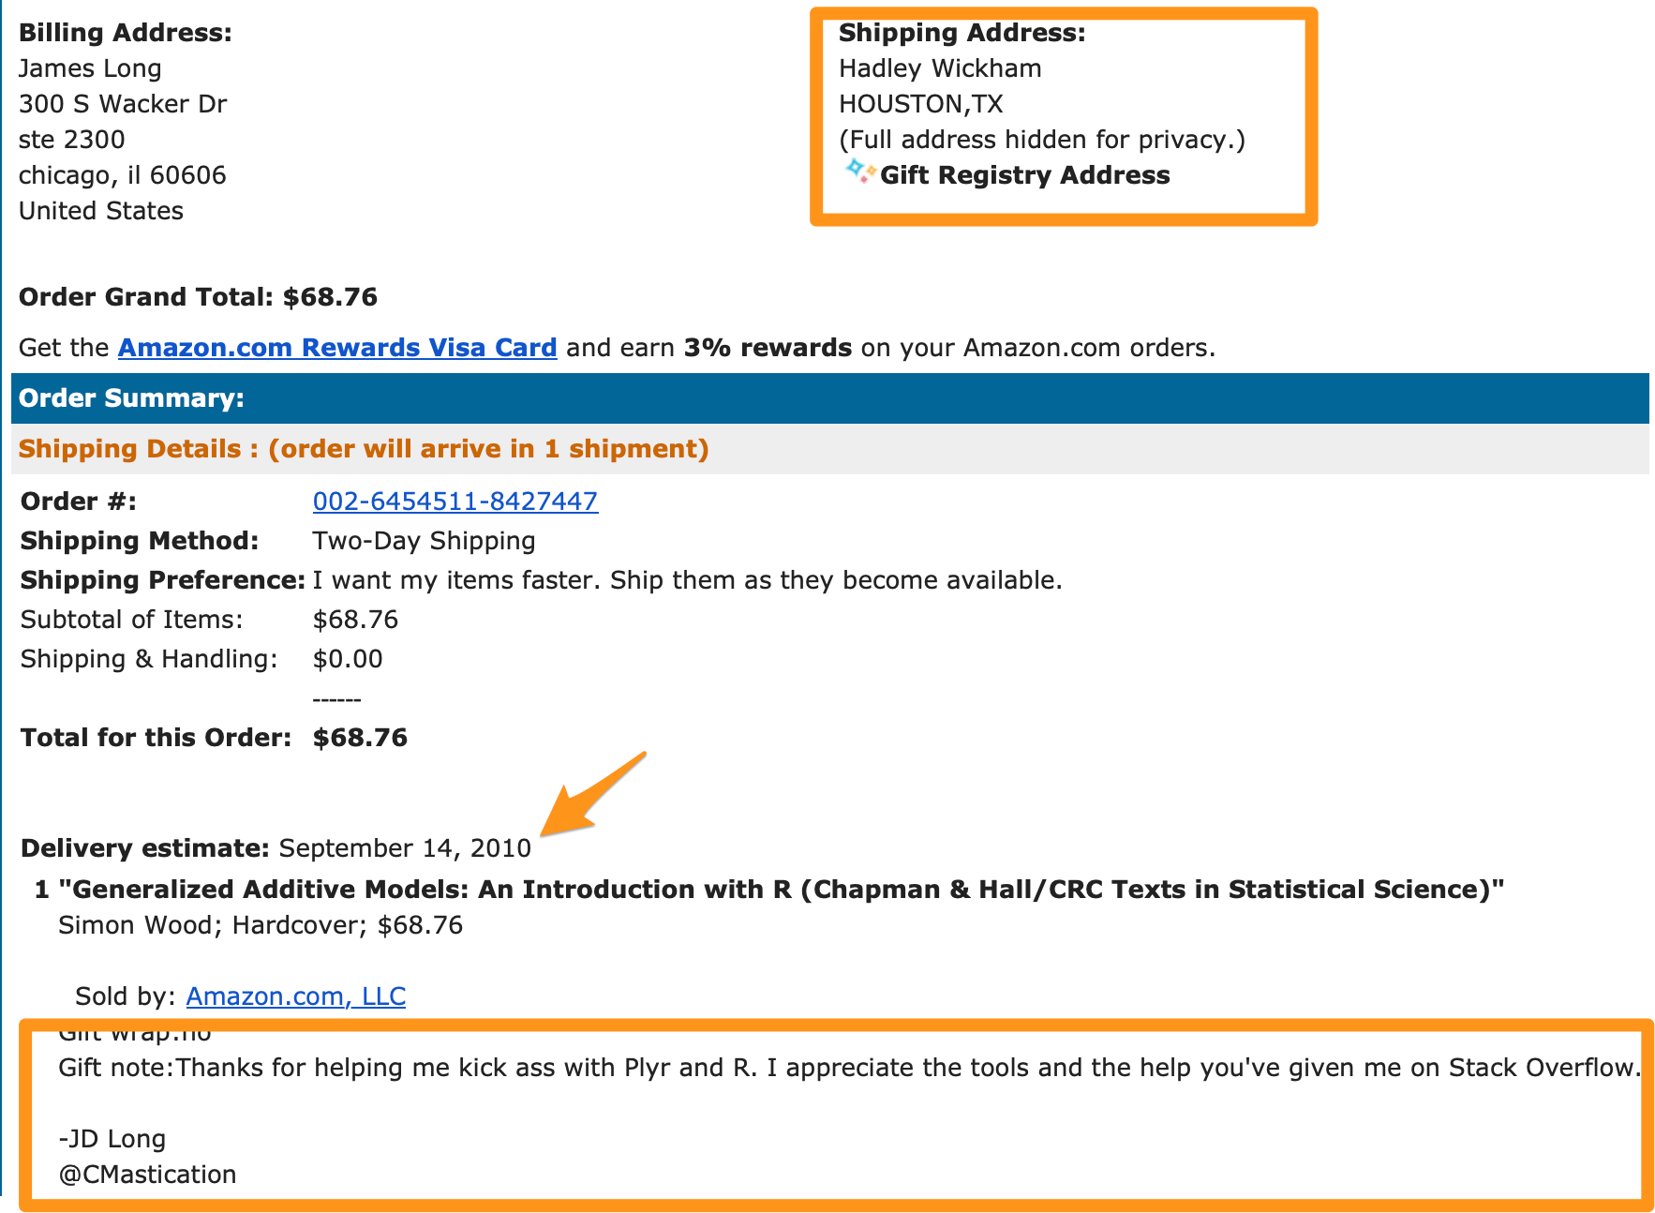

Slide 4
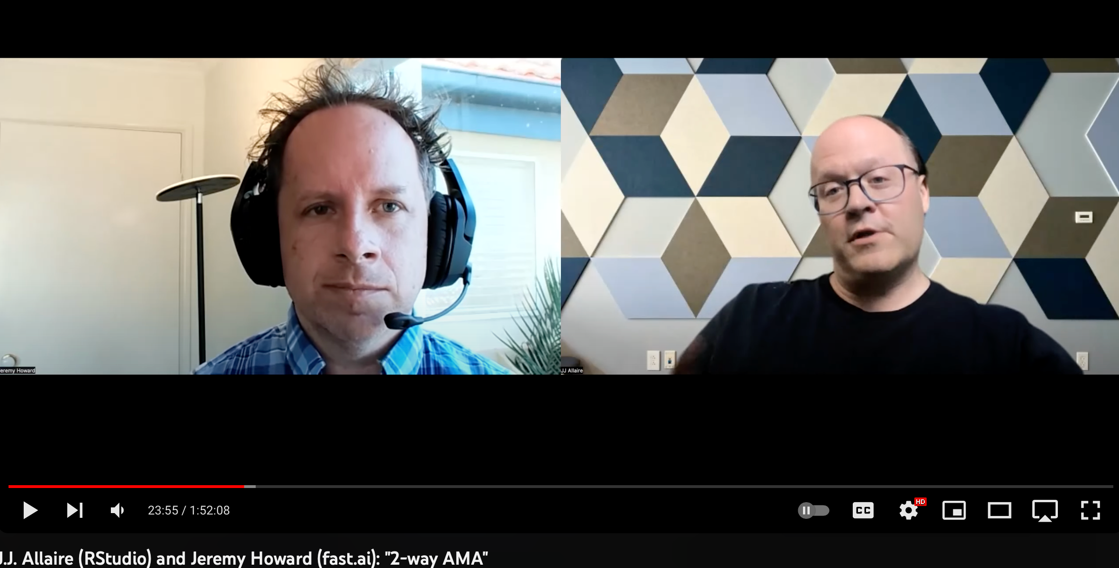
if you think about how you help both new users ramp into things and make experienced users productive, you provide these abstractions and there's a dial of how leaky you want you let the abstractions be

Slide 5


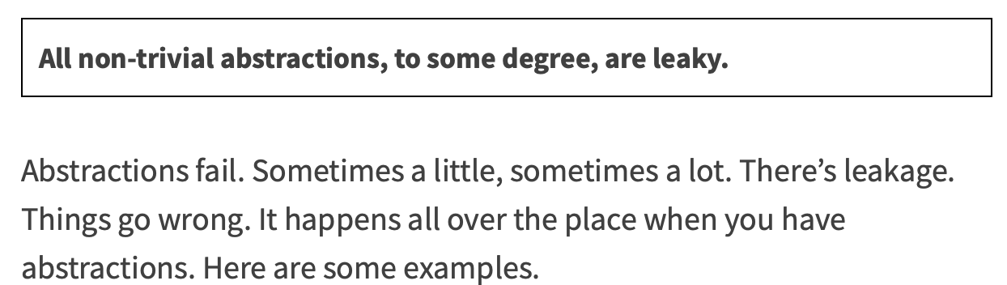

Slide 6
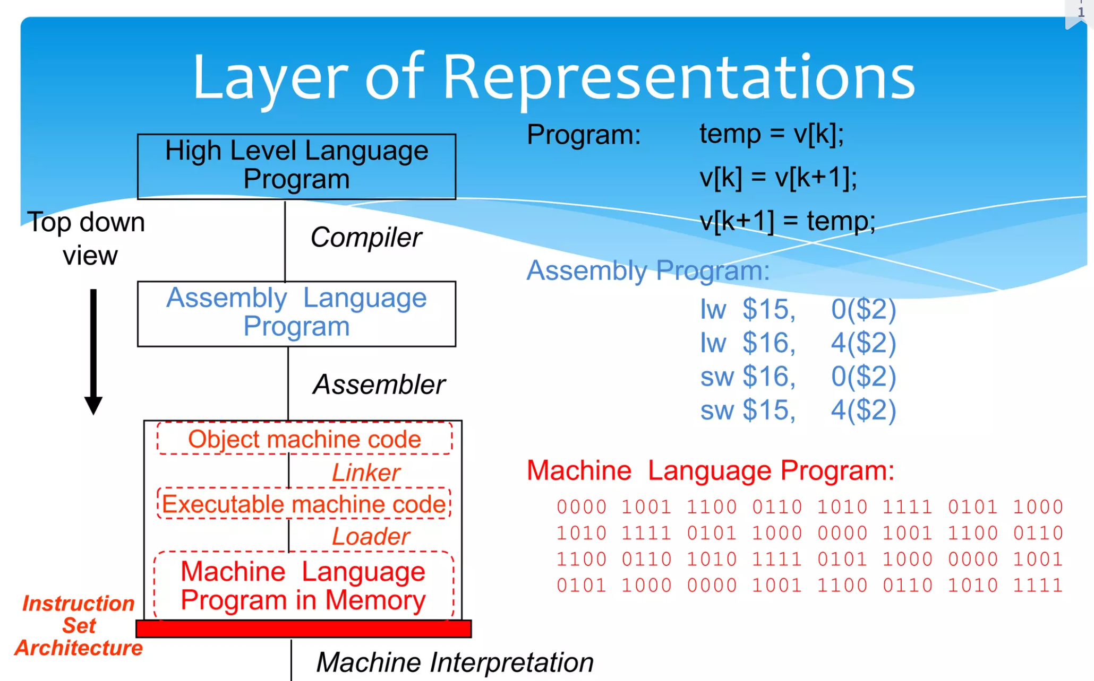
Roger Duran: https://www.slideshare.net/RogerDuran/intro-lesson1comp-arch

Slide 7
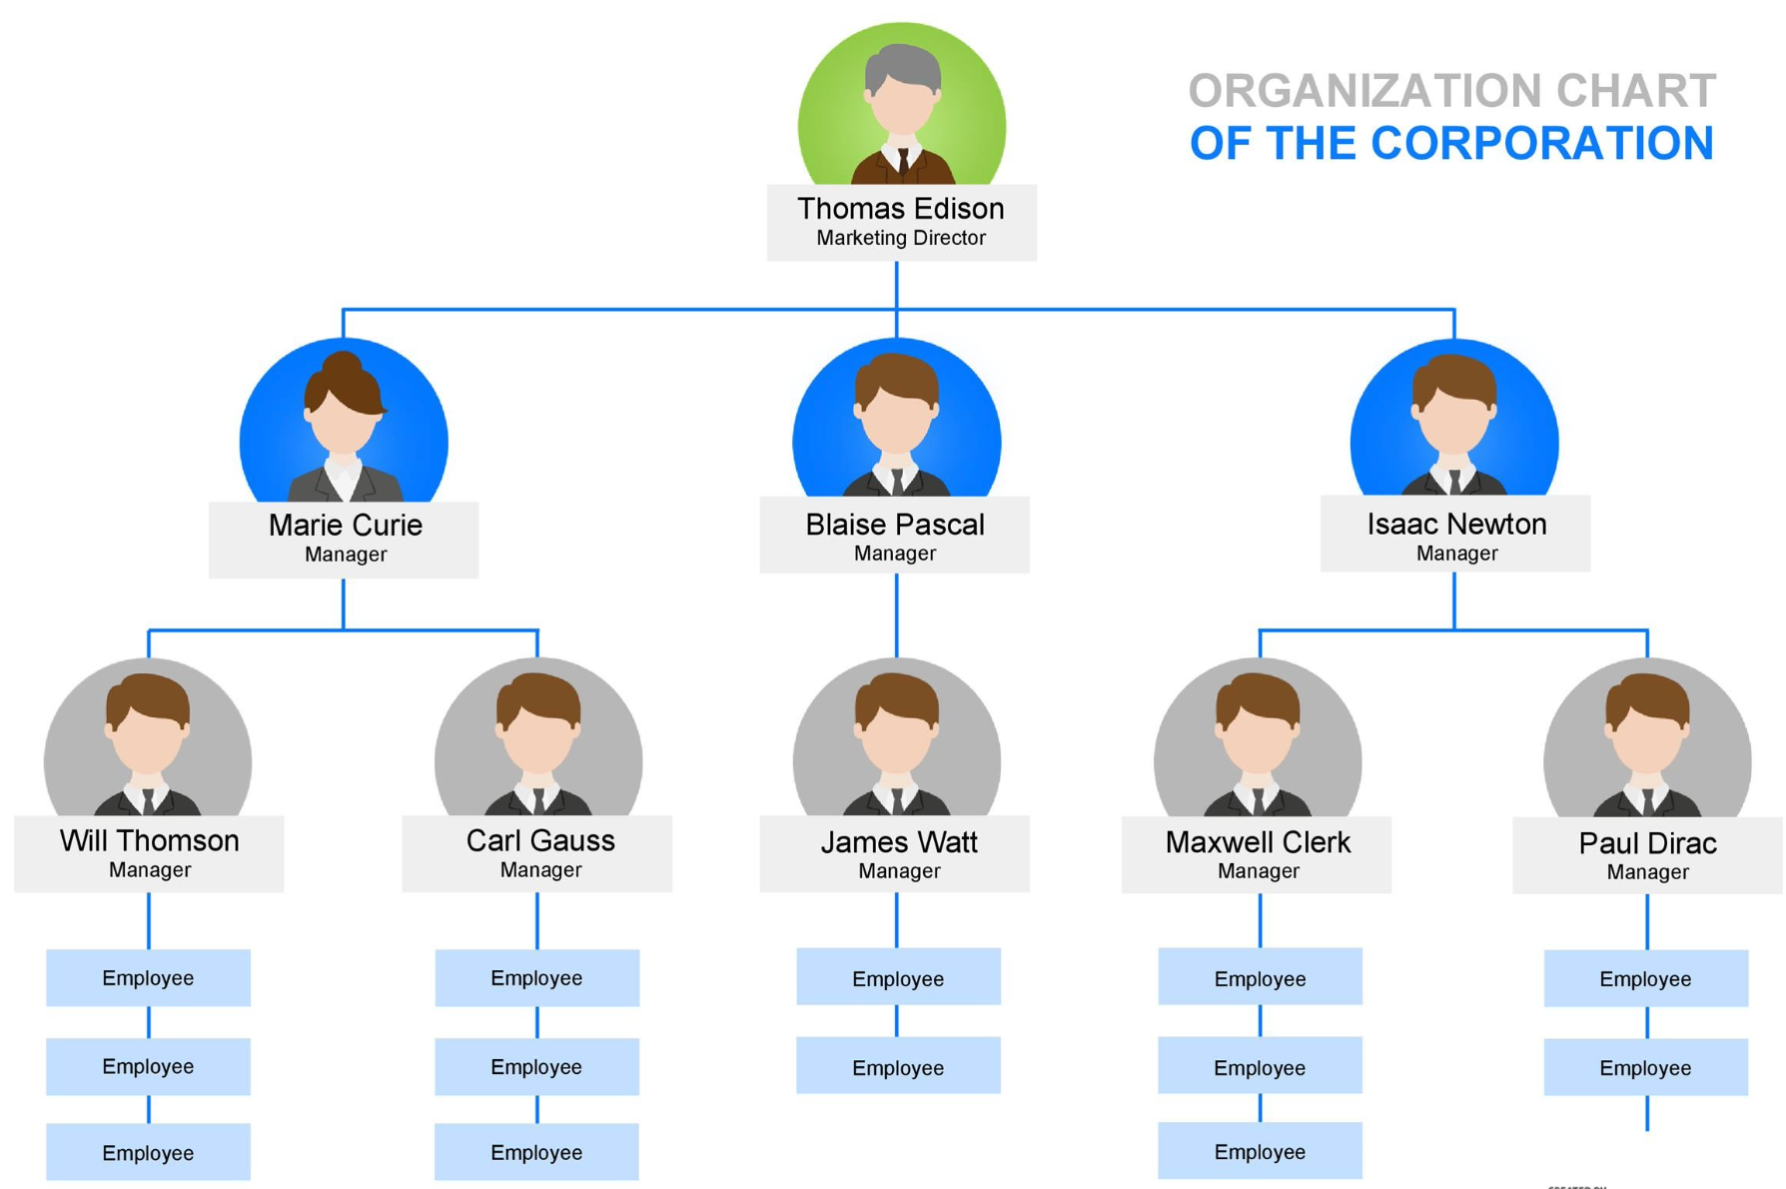
Organizational Abstraction
Board of Directors
Executive Management
Department Heads
Team Leads
Team Contributors

Slide 8

Y Tho?

Slide 9
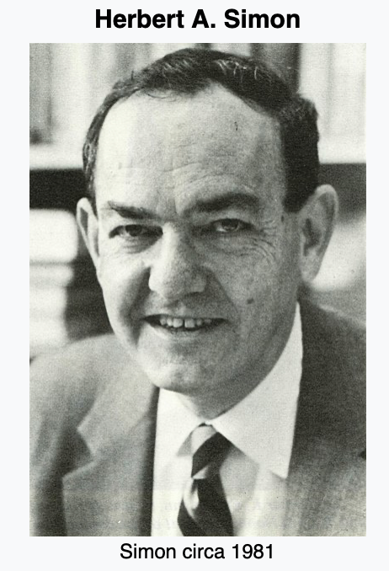
Bounded Rationality
1957a, Administrative Behavior: A Study of Decision-Making Processes in Administrative Organization, second edition, New York: Macmillan.
tl;dr: “Head trunk only hold so much junk”

Slide 10
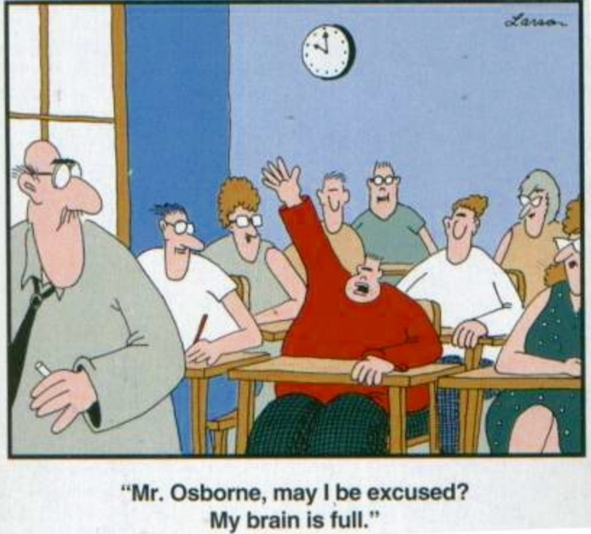

Slide 11


Slide 12
Know your limits…
Know which abstractions you really understand
Recognize when you are up against an abstraction you don’t grok
Choose between learning the new abstraction and partnering with an expert
Don’t blame an abstraction for your problems if you haven’t learned it

Slide 13
“Programming, when stripped of all its circumstantial irrelevancies, boils down to no more and no less than very effective thinking so as to avoid unmastered complexity, to very vigorous separation of your many different concerns.” ― Edsger W. Dijkstra in 1975
tl;dr – constrain complexity and separate concerns

Slide 14
Electricity is a fundamental abstraction for computing… How fast do the electrons flow in our wires?

Slide 15
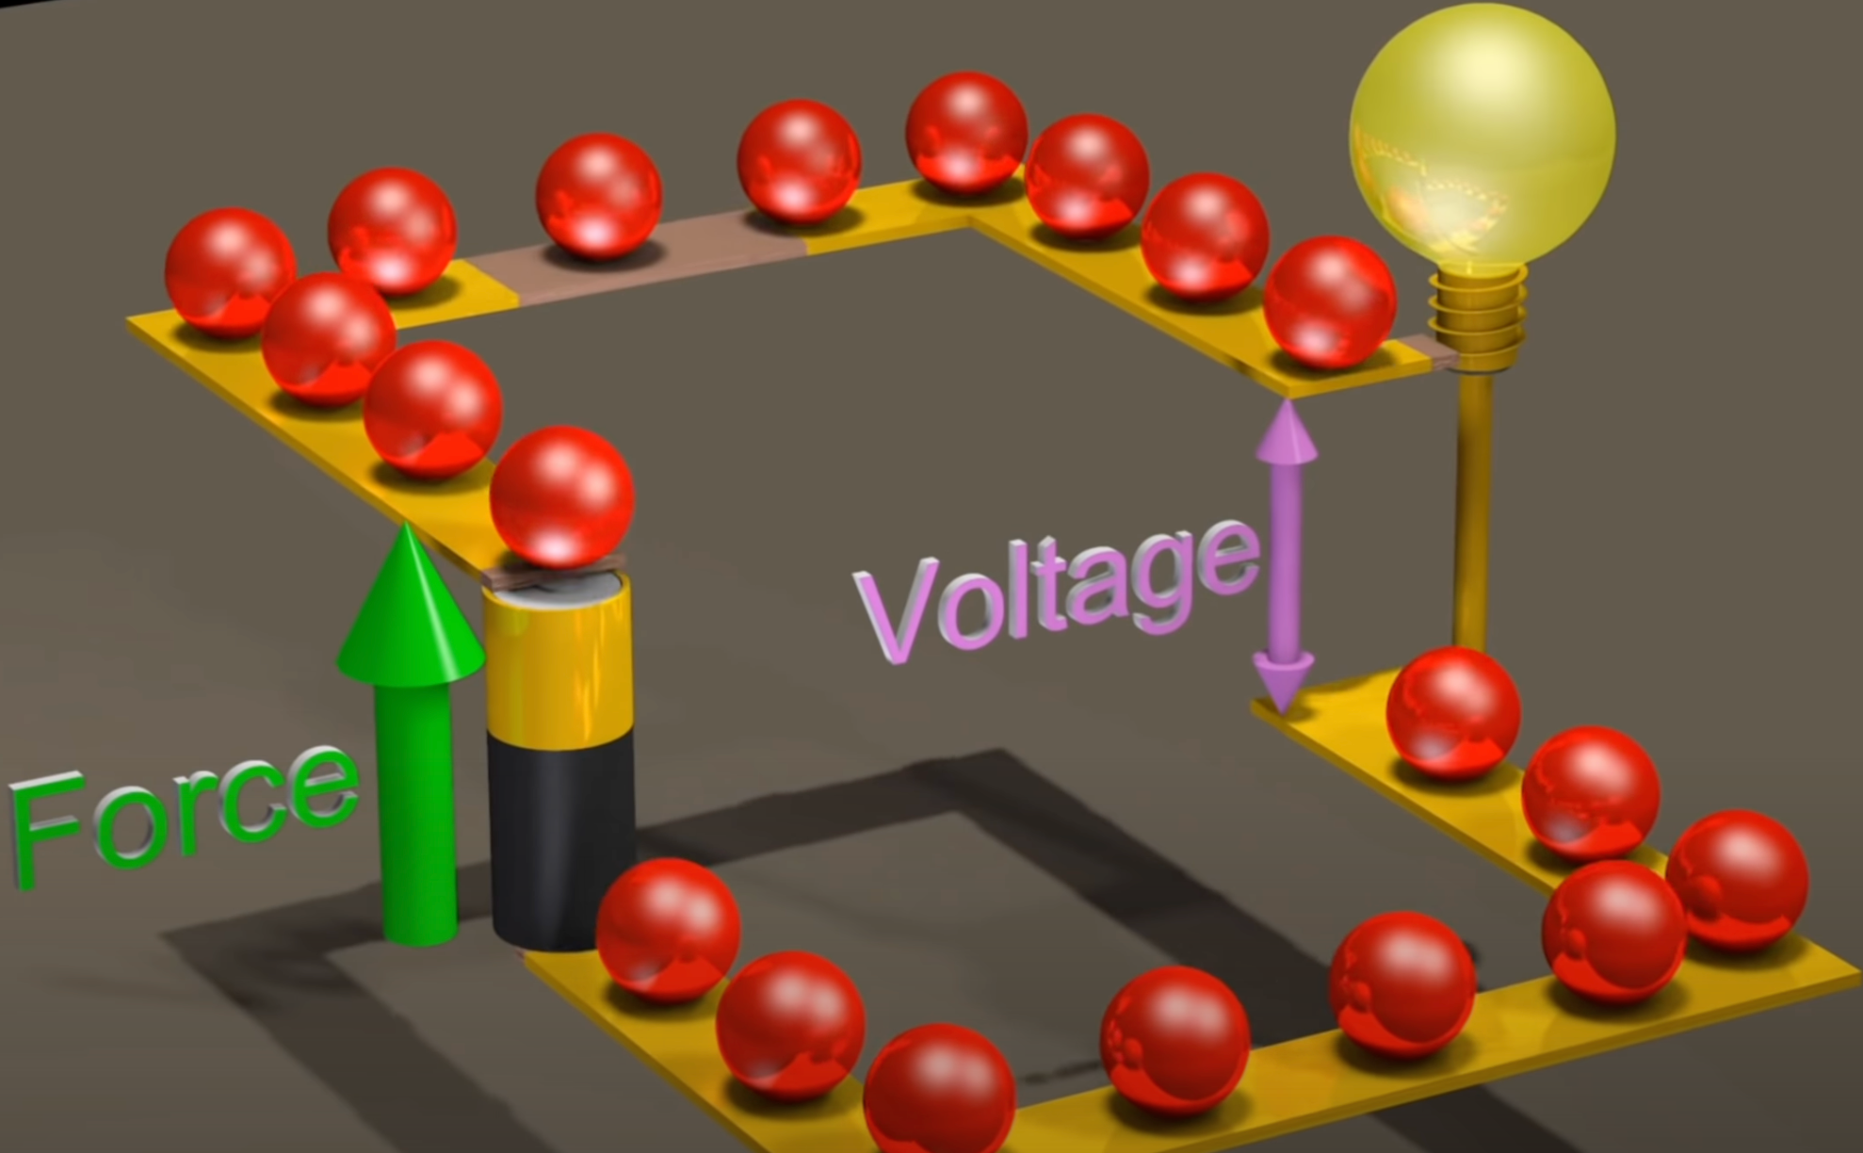

Slide 16
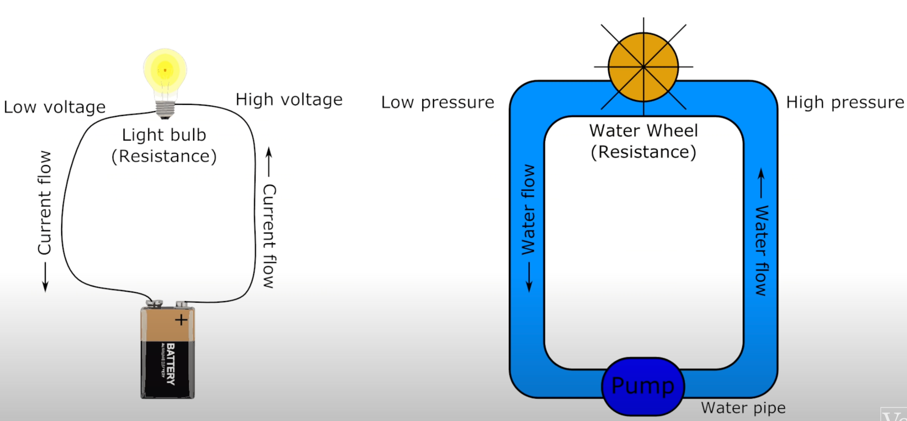

Slide 17
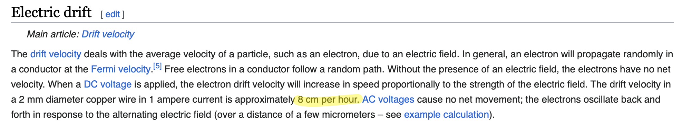
How fast do the electrons flow in our wires? 8 cm per hour We conflate electromagnetic fields with electron movement

Slide 18

https://bit.ly/jdl-electron

Slide 19
Why do many of us not know this?

Slide 20

Why do many of us not know this?

Slide 21
To understand abstractions we build mental models. Often we use metaphors. Often WRONG metaphors.

Slide 22
What if our mental model is wrong and it DOES matter?

Slide 23
Let’s talk about floating point math

Slide 24
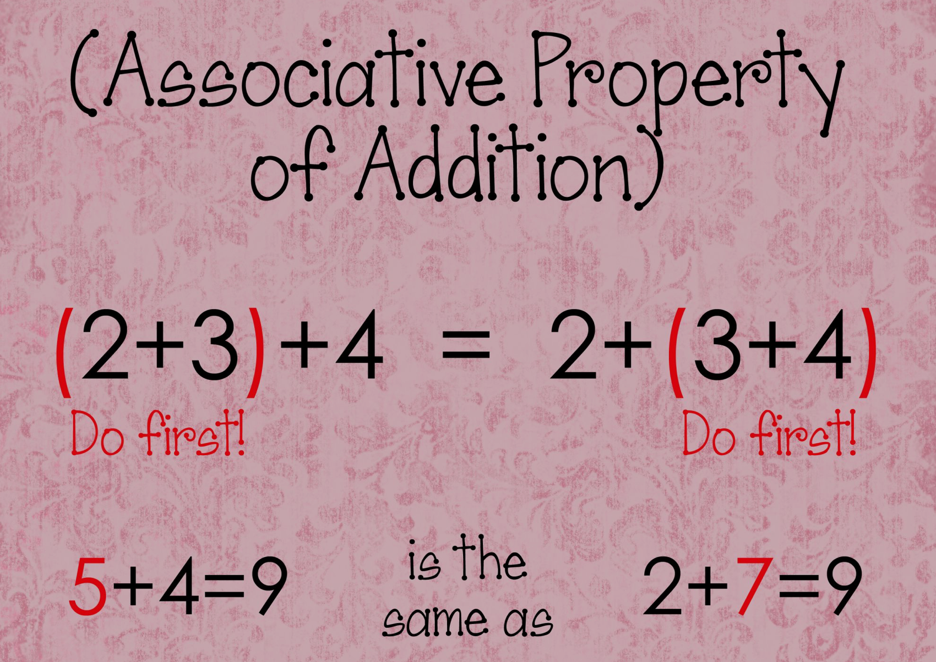
Addition and Multiplication are Associative

Slide 25
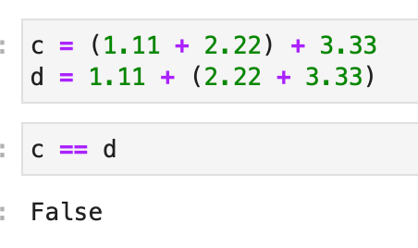

Slide 26
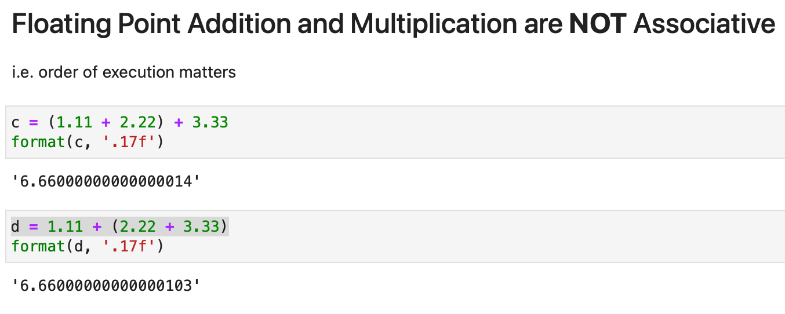

Slide 27
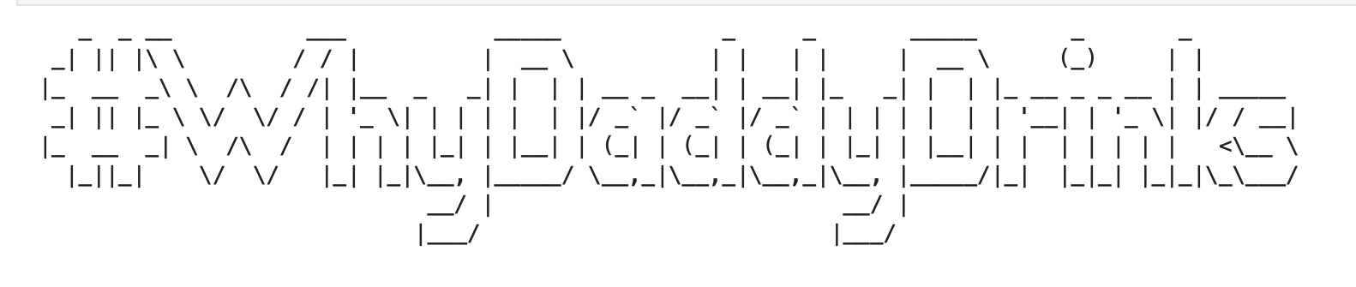

Slide 28
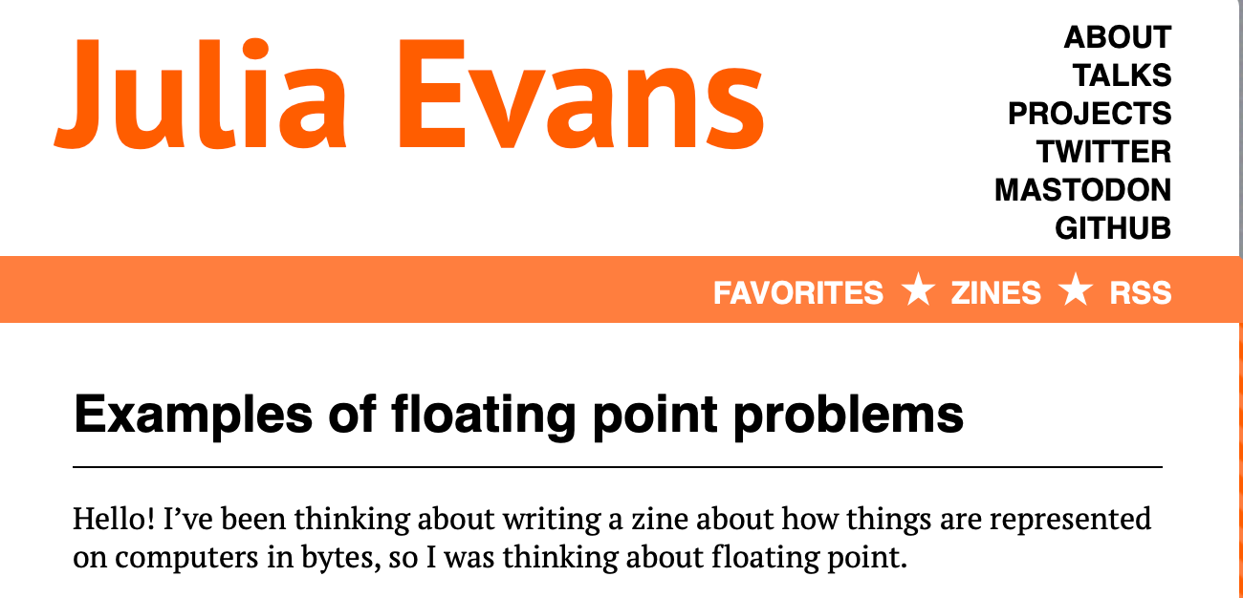
Most of us are NOT computer scientists
“Doing numerical computations on a computer inherently involves some approximation and rounding”
https://bit.ly/evans_floating

Slide 29

What about organizational abstraction fails?

Slide 30
Org Abstraction Leakage:
Where did this number in the DB come from?
Who do I talk to about solving this?
How was this decision made?

Slide 31
General Evidence of Leaking Abstractions?
Unexpected behavior
Uninterpretable responses
Logical errors

Slide 32
It’s Like Beer…
Communication is the source of, and solution to, all our problems.
Where did this number in the DB come from?
Code accessibility in Version Control
Wiki pages describing processes
Who do I talk to about solving this?
Clear Ownership of everything in the org
How was this decision made?
Better transparency
Leadership communication

Slide 33
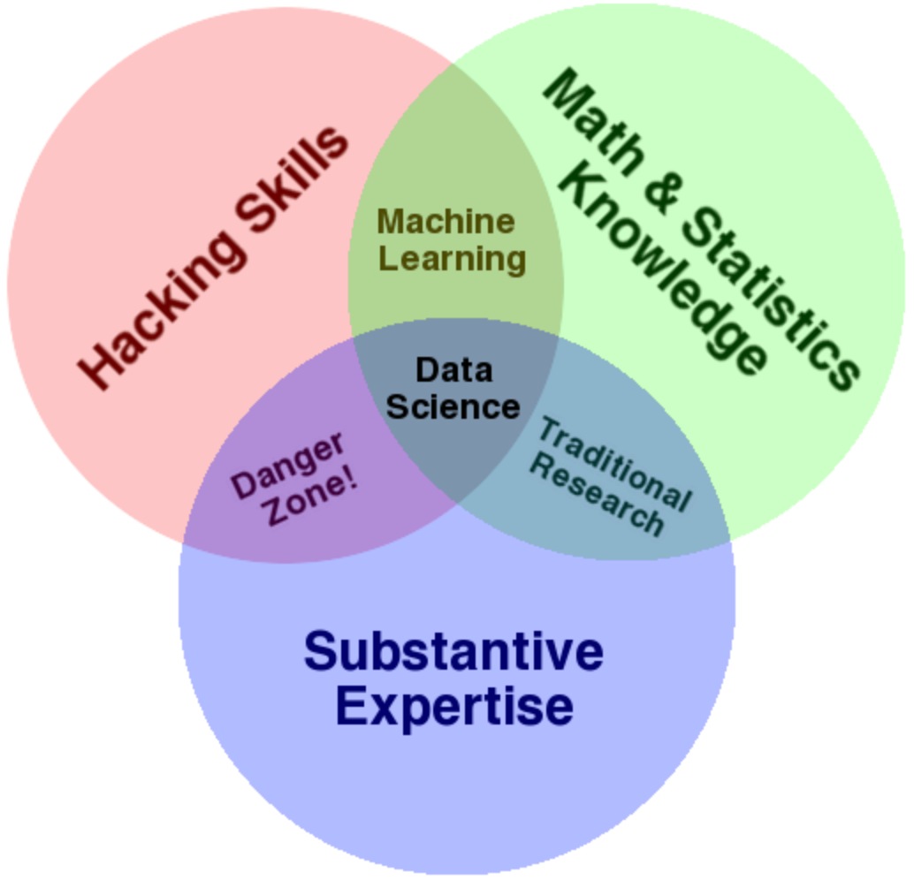
A Little History: Drew Conway’s Venn Diagram 2010

Slide 34
JD’s Assertion 1:
"The single biggest business value derived from the data science movement in the last 13 years is making it legitimate to code outside of IT roles"
Data Science type roles break previous organizational abstractions.

Slide 35
JD’s Assertion 2:
”Abstractions will leak. Therefore, abstractions must be permeable to allow debugging."
Holds for both organizations and computers.

Slide 36

JD’s Assertion 3:
”No single abstraction is right for everyone."

Slide 37
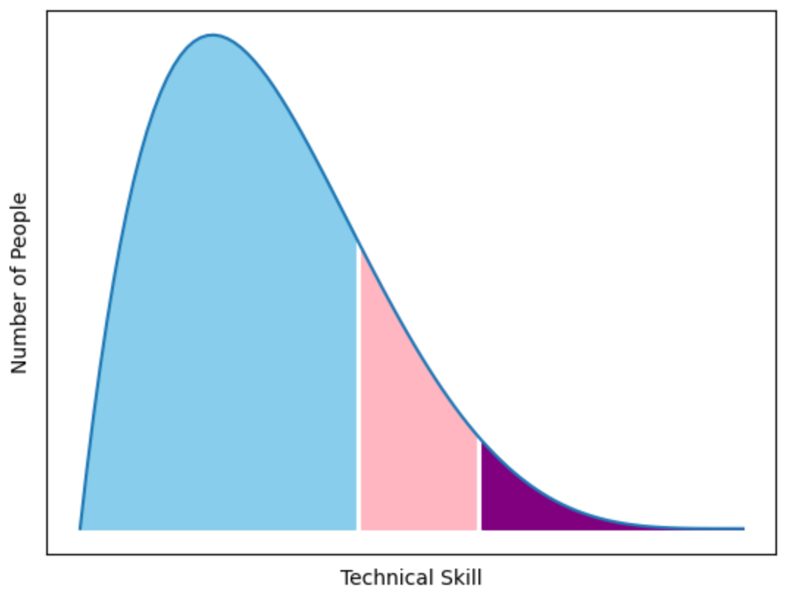
80-16-4
80% Normal Business Users:
Applications, Dashboards & Basic Excel
16% Super Users:
SQL, Custom Dashboards, and Advanced Excel
4% Guru Users:
APIs & Code Based Tooling

Slide 38
Multiple Abstractions is a High Empathy Move

Slide 39
Big Idea Recap:
Abstractions Start WAAAAY Up With Leaders and go Down to the Hardware
To Debug an Abstraction You Have to See Below It
We’re Building Mental Models of Complex Systems
You Can’t Master All Abstractions
Decide if You’re Going to Learn or Partner
Ensure an Abstraction for Everyone: 80-16-4
Help Everyone Kick Ass!

Slide 40


LinkedIn: https://www.linkedin.com/in/jamesdlong/
Mastodon: https://mastodon.social/@Cmastication

